Slide 1






Detecting Spam Mail
Student Details
Name : SANDHIYA. B
NM Id : au612721105031
College Name : THE KAVERY ENGINEERING COLLEGE

Slide 2
Disclaimer
The content is curated from online/offline resources and used for educational purpose only

Slide 3

Course Outline
Abstract
Problem Statement
Aims, Objective & Proposed System/Solution
System Deployment Approach
Model Development & Algorithm
Future Scope
Video of the Project
Conclusion
Reference

Slide 4

Abstract
The ubiquity of email communication has brought forth the persistent challenge of spam messages, posing threats to user privacy and security. This project endeavors to develop a proficient system for the detection of spam emails through the utilization of machine learning algorithms. The proposed system will leverage a diverse array of features such as sender analysis, content inspection, and linguistic patterns to discern between legitimate correspondence and spam. By harnessing a dataset comprising labeled emails, we will train and evaluate several machine learning models, including Support Vector Machines, Naive Bayes, and Random Forests. The project's primary objective is to construct a robust spam detection mechanism that can bolster email security, mitigate the risks associated with phishing attacks, and augment user experience. The outcomes of this endeavor are poised to make significant contributions towards combatting the proliferation of spam within the digital landscape.

Slide 5

Problem Statement
Facial emotion recognition in real-time is challenging due to human expression variability. Traditional methods struggle with accuracy, especially considering age as a factor.
Develop a system for face emotion and age detection that accurately identifies both the emotions and approximate age of individuals from facial images. This system should be robust, efficient, and capable of processing images in real-time or near real-time.

Slide 6

Aim and Objective
Aim: The primary aim of this project is to design and implement a robust system for the automated detection of spam emails utilizing machine learning algorithms. The system will employ a multi-faceted approach, integrating sender analysis, content examination, and linguistic pattern recognition to differentiate between legitimate emails and spam

Slide 7
Objectives
Develop Feature Extraction Methods: Implement methods to extract relevant features from email data, including sender information, email content, metadata, and linguistic characteristics.
Explore Machine Learning Algorithms: Investigate and evaluate various machine learning algorithms such as Support Vector Machines, Naive Bayes, and Random Forests for their effectiveness in spam detection.
Construct Training and Testing Framework: Create a comprehensive dataset of labeled emails for training and testing purposes, ensuring a diverse representation of spam and legitimate messages.
Optimize Performance Metrics: Strive to achieve high accuracy, precision, recall, and F1-score metrics to ensure the reliability and effectiveness of the spam detection system.
Enhance Email Security: Ultimately, the project seeks to contribute to the enhancement of email security measures, reducing the risk of users falling victim to phishing attacks and improving overall user experience.

Slide 8
Proposed Solution
Solution: The proposed solution for the "Detecting Spam Mail" project involves the development and implementation of a comprehensive system that employs machine learning algorithms to accurately classify emails as either spam or legitimate. This system will consist of the following key components.
Feature Extraction:
Implement feature extraction techniques to gather relevant information from incoming emails. This includes:
Sender Analysis: Extract sender email addresses and analyze their reputation based on past interactions.
Feature Extraction:
Implement feature extraction techniques to gather relevant information from incoming emails. This includes:
Sender Analysis: Extract sender email addresses and analyze their reputation based on past interactions.
Training and Evaluation:
Construct a robust dataset comprising labeled examples of spam and legitimate emails for training and testing purposes.
Notes:
8

Slide 9
Real-time Scoring and Filtering:
Implement a real-time scoring system where incoming emails are processed through the trained models to determine their spam likelihood.
Iterative Improvement:
Continuously monitor the system's performance in a live environment and gather feedback on its effectiveness.
Implement iterative improvements such as retraining the models with new data, adjusting feature extraction methods, or exploring ensemble techniques for enhanced accuracy.

Slide 10
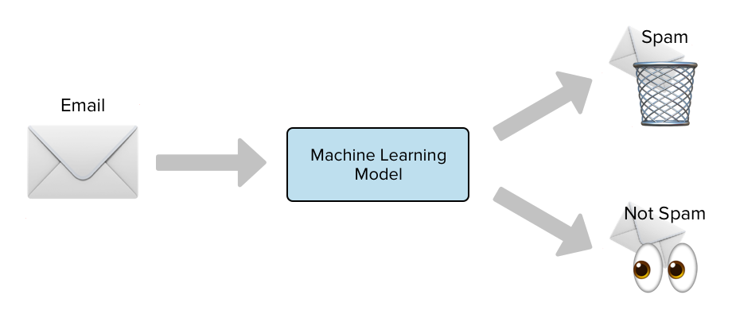
System Deployment Approach
Notes:
10

Slide 11
Model Development & Algorithm
Dataset Description:
The dataset contains on the text format.
Memory usage: 87.2+ KB of data was used
Categorized into two classes
Ham, spam
Each classes has 5572 rows x 5 columns
Notes:
11

Slide 12
Model Development & Algorithm
Dataset Description
We’ll work with the Email Spam Classification Dataset, which contains information about 5,172 emails. The dataset is available in CSV format and includes labels indicating whether each email is spam or not. You can find the dataset on Kaggle, specifically in the Email Spam Classification Dataset CSV
Data Cleaning
To begin, we load the dataset from the CSV file and perform data cleaning to ensure it’s suitable for analysis. Here are the steps involved:
Load the Data: Read the CSV file containing email data.
Drop Unnecessary Columns: Remove any unnecessary columns (e.g., ‘Unnamed: 2’, ‘Unnamed: 3’, ‘Unnamed: 4’).
Encode the Target Variable: Encode the target variable (‘spam’ or ‘not spam’) using label encoding.
Handle Missing Values: Check for missing values and handle them appropriately.
Remove Duplicates: Eliminate duplicate rows from the dataset
Notes:
12

Slide 13
Exploratory Data Analysis (EDA)
EDA is essential for understanding the dataset’s characteristics and gaining insights into the distribution of spam and non-spam emails. Visualizations like pie charts, histograms, and pair plots help analyze character count, word count, and sentence count. Let’s take a look at the data distribution:
Class Distribution:
Not Spam: X emails
Spam: Y emails
(Visualized using a pie chart)

Slide 14
Model Development
We’ll use machine learning techniques to build our spam email detection model. Commonly used algorithms include logistic regression, Naive Bayes, and neural networks. Feature extraction (e.g., TF-IDF) plays a crucial role in model training.
Model Evaluation and Improvement
Evaluate the model’s accuracy on training and test data. Fine-tune hyper parameters and explore other techniques to improve performance.

Slide 15
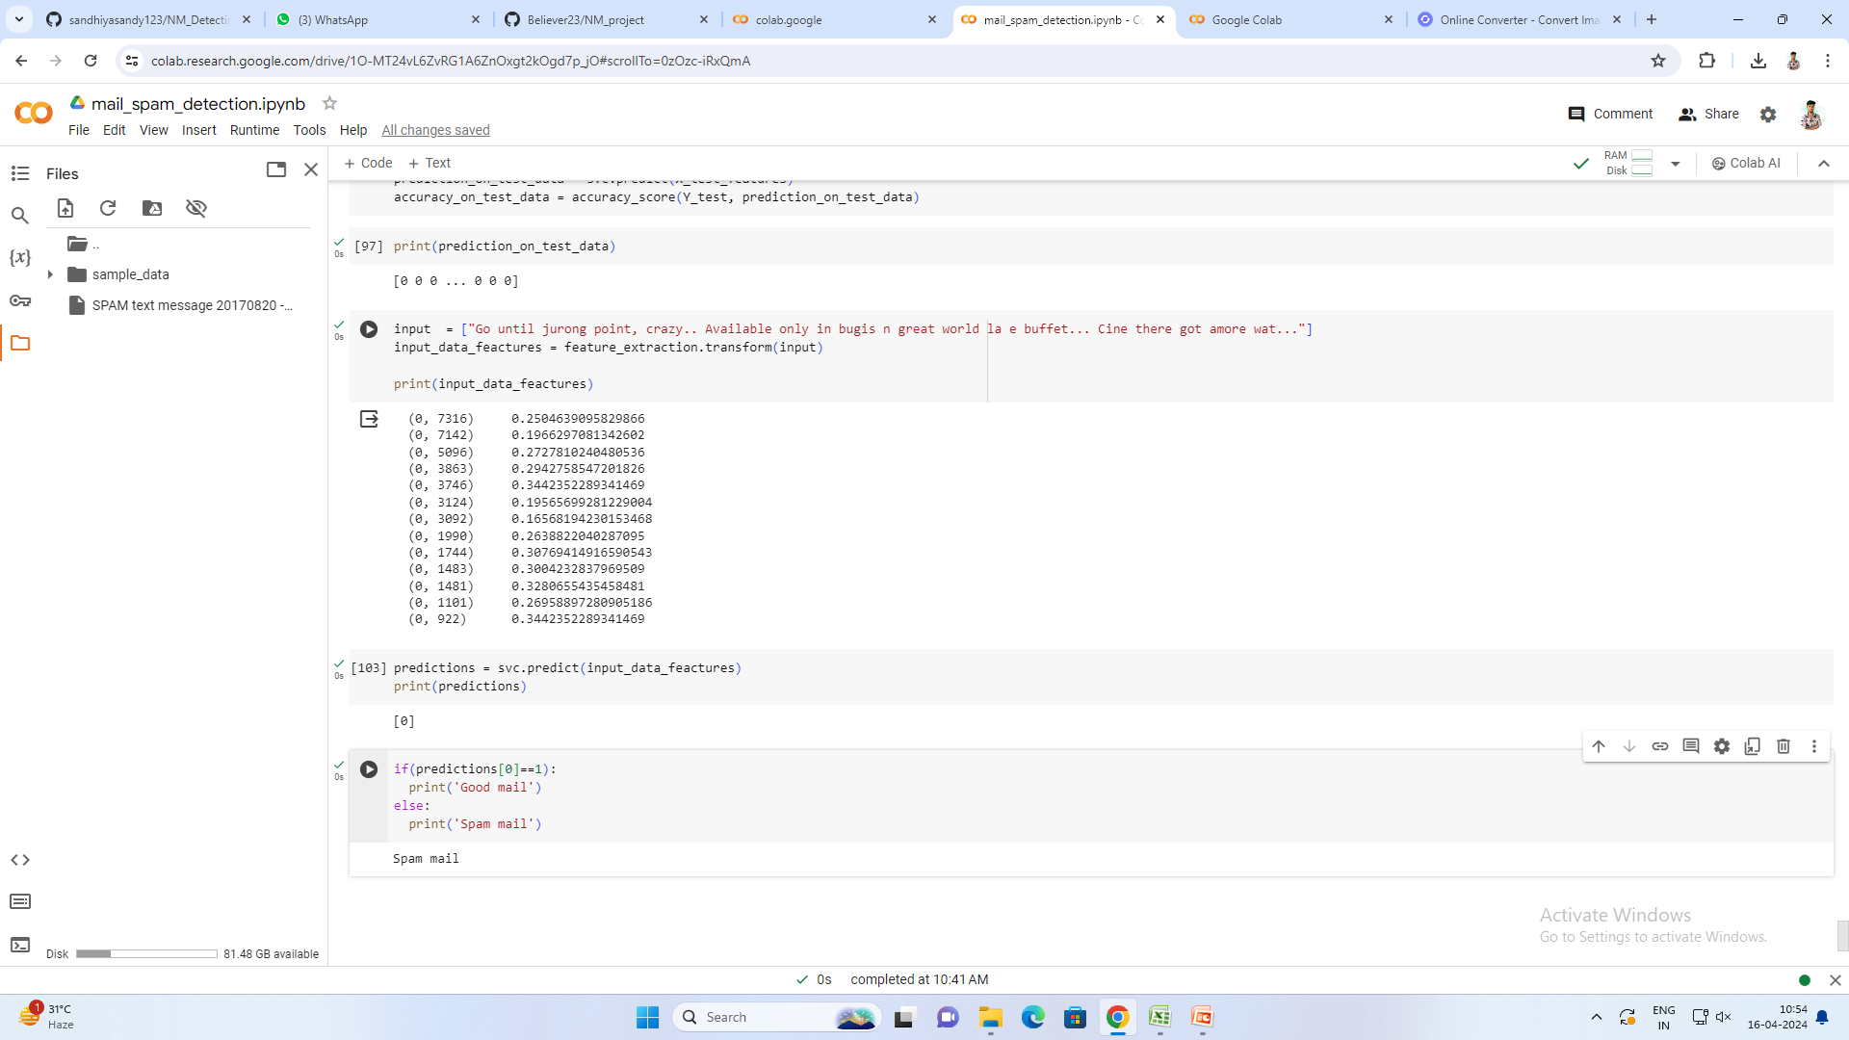
Result
Notes:
15

Slide 16

Future Scope
Emotion monitoring:
Extend your spam detection model to analyze the emotional tone of emails. Sentiment analysis can help identify emotionally charged content, which may be relevant for user experience or targeted marketing.
Therapeutic applications
Investigate how your spam detection model can be adapted for therapeutic purposes. For example:
Mental Health Support:
Use email content to identify signs of distress or mental health issues in users. Provide appropriate resources or alerts.
Notes:
16

Slide 17
Wellness Reminders: Send personalized wellness reminders or motivational messages based on email content.
Enhanced Security: Collaborate with cyber security experts to enhance email security beyond spam detection:
Phishing Detection: Extend your model to identify phishing attempts or suspicious links.
Malware Detection: Analyze attachments for potential malware.
Spoofed Emails: Detect spoofed sender addresses.

Slide 18

Notes:
18

Slide 19

Conclusion
Building an effective spam email detection model involves a series of crucial steps, from data cleaning and exploratory data analysis to model development and evaluation. Here’s a summary of our journey
We loaded the Email Spam Classification Dataset containing information about 5,172 emails.
Unnecessary columns were dropped, and the target variable was encoded.
Missing values were handled, and duplicate rows were removed.
We visualized the distribution of spam and non-spam emails using pie charts.
EDA helped us understand the dataset’s characteristics and identify potential patterns.
Notes:
19

Slide 20
Reference
https://youtu.be/cNLPt02RwF0?si=P2IxHugi6FZh5Fh1
Notes:
Reference
These are the references for this session.

Slide 21
Thank you!
Notes:
21

